Slide 1

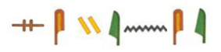
Notes:
I read books here.
I eat lunch here.
I learn art here.
I put my shoes here.
I learn science here.
English Camp Room

